Slide 1
Deep Convolution Neural Networks and Applications
Sudeep Reddy G

Slide 2






Traditional Recognition Approach
Image/ Video Pixels
Hand-designed feature extraction
Trainable classifier
Object Class
Features are not learned
Trainable classifier is often generic (e.g. SVM)

Slide 3
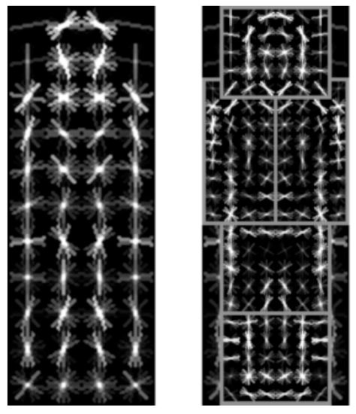
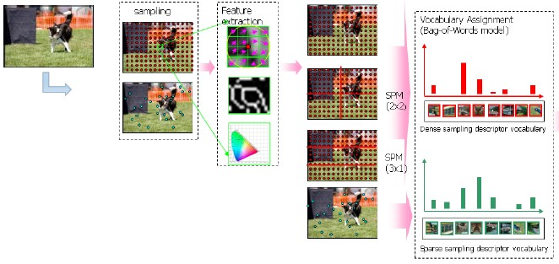

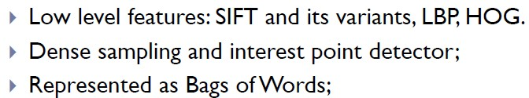
Traditional Recognition Approach
Features are key to recent progress in recognition
Multitude of hand-designed features currently in use
SIFT, HOG, ………….
Where next? Better classifiers? Or keep building more features?
Felzenszwalb, Girshick, McAllester and Ramanan, PAMI 2007
Yan & Huang
(Winner of PASCAL 2010 classification competition)

Slide 4









What about learning the features?
Learn a feature hierarchy all the way from pixels to classifier
Each layer extracts features from the output of previous layer
Train all layers jointly
Image/ Video Pixels
Layer 1
Layer 2
Layer 3
Simple Classifier

Slide 5
Overview
Shallow vs. deep architectures
Background
Traditional neural networks
Inspiration from neuroscience
CNN - Basics
Stages of CNN architecture
Visualizing CNNs
State-of-the-art results
Packages
Applying to detect bumps

Slide 6














“Shallow” vs. “deep” architectures
Traditional recognition: “Shallow” architecture
Image/ Video Pixels
Hand-designed feature extraction
Trainable classifier
Object Class
Deep learning: “Deep” architecture
Image/ Video Pixels
Simple classifier
Layer 1
…
Layer N
Object Class

Slide 7
Overview
Shallow vs. deep architectures
Background
Traditional neural networks
Inspiration from neuroscience
CNN - Basics
Stages of CNN architecture
Visualizing CNNs
State-of-the-art results
Packages
Applying to detect bumps

Slide 8
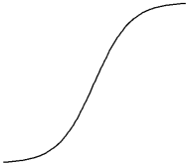
Background: Perceptrons
Input
Weights w₁
x₁
x₂
w
2
Output: σ(w⋅x + b)
x₃
.
.
.
x_{d}
w₃
Sigmoid function:
1
σ (t) =
w_{d}
1+ e^{−t}

Slide 9
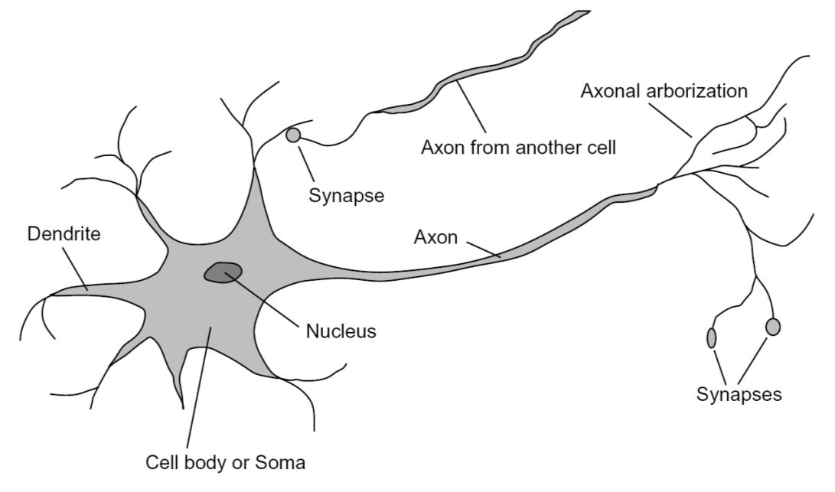
Inspiration: Neuron cells

Slide 10
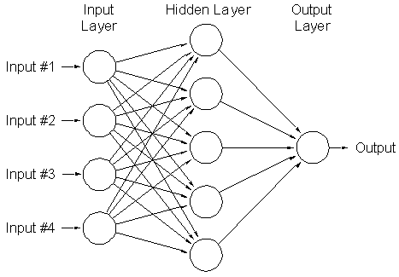
Background: Multi-Layer Neural Networks
Nonlinear classifier
Training: find network weights w to minimize the error between true training labels y_{i} and estimated labels f_{w}(x_{i}):
N
E(w) =
∑
(y − f (x ))
2
i w i
i=1
Minimization can be done by gradient descent provided f is differentiable
This training method is called back-propagation

Slide 11
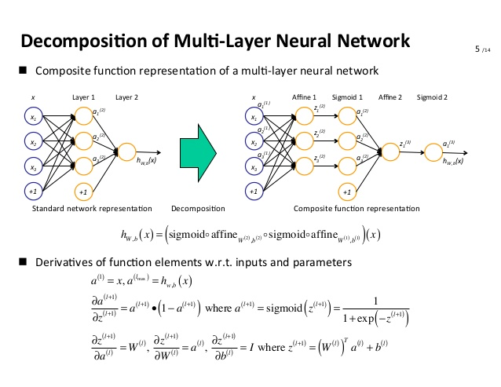

Slide 12
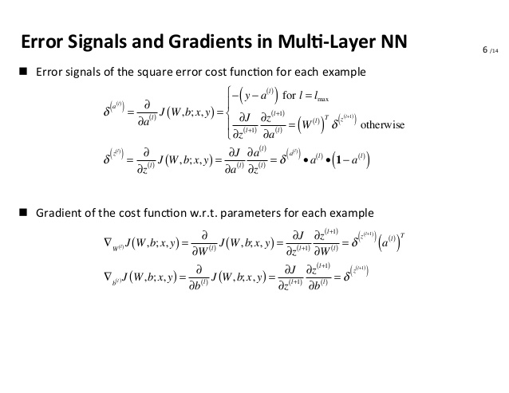

Slide 13
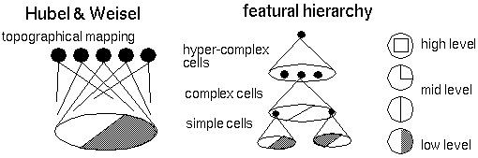
Hubel/Wiesel Architecture
D. Hubel and T. Wiesel (1959, 1962, Nobel Prize 1981)
Visual cortex consists of a hierarchy of simple, complex, and hyper-complex cells
Source

Slide 14
Overview
Shallow vs. deep architectures
Background
Traditional neural networks
Inspiration from neuroscience
CNN - Basics
Stages of CNN architecture
Visualizing CNNs
State-of-the-art results
Packages
Applying to detect bumps

Slide 15
Terminologies
Receptive Field
Kernel/Weights/Filters
Stride
Padding

Slide 16

5x5 Input Volume (W)
3x3 Receptive Field(F)
- Stride (S)
0 - Padding(P)
O/p Dimensions = (W-F+2P)/S) + 1
= (5-3+0)/1 +1
= 3

Slide 17
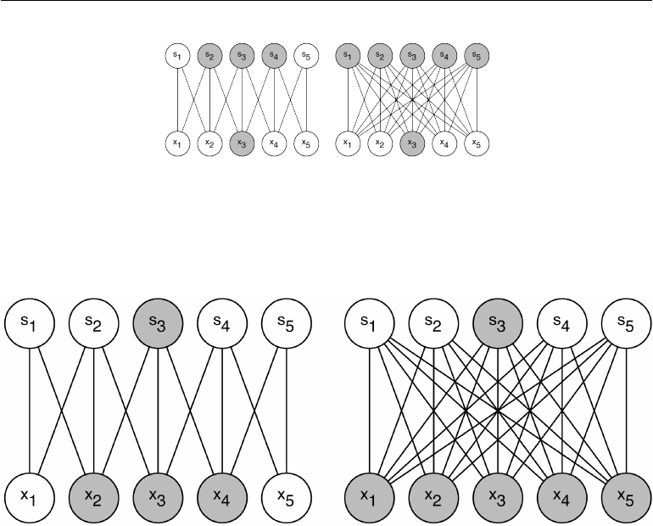
Connectivity of Neurons in Convolution Neural Network
Sparse Connectivity
Parameter Sharing
Equivariance
N+1
N

Slide 18

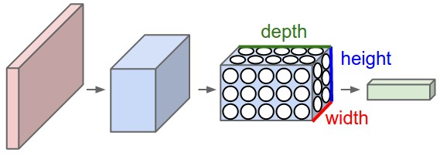
Top: A regular 3-layer Neural Network.
Bottom: A ConvNet arranges its neurons in three dimensions (width, height, depth), as visualized in one of the layers. Every layer of a ConvNet transforms the 3D input volume to a 3D output volume of neuron activations.

Slide 19
Overview
Shallow vs. deep architectures
Background
Traditional neural networks
Inspiration from neuroscience
CNN - Basics
Stages of CNN architecture
Visualizing CNNs
State-of-the-art results
Packages
Applying to detect bumps

Slide 20
Convolutional Neural Networks (CNN, Convnet)
Feed-forward feature extraction:
Feature maps
Convolve input with learned filters
Non-linearity
Spatial pooling
Normalization
Normalization
Supervised training of convolutional filters by back-propagating classification error
Spatial pooling
Non-linearity
Convolution (Learned)
Input Image

Slide 21
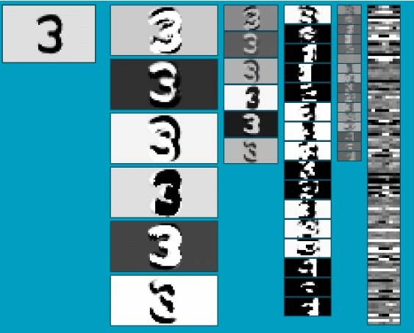
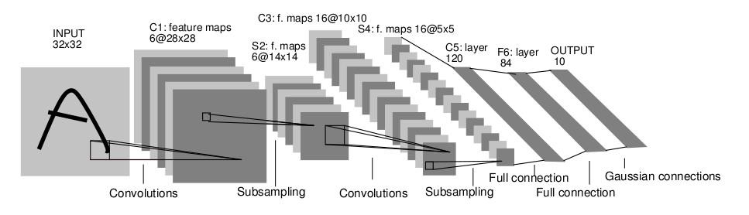
Convolutional Neural Networks (CNN, Convnet)
Neural network with specialized connectivity structure
Stack multiple stages of feature extractors
Higher stages compute more global, more invariant features
Classification layer at the end
Y. LeCun, L. Bottou, Y. Bengio, and P. Haffner, Gradient-based learning applied to document recognition, Proceedings of the IEEE 86(11): 2278–2324, 1998.

Slide 22
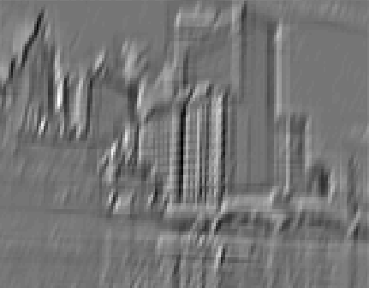
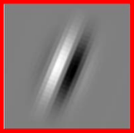
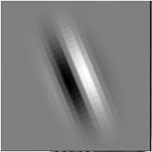
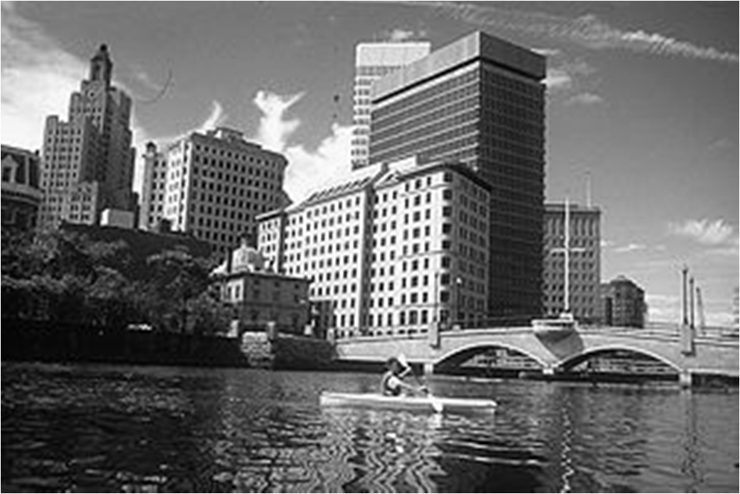

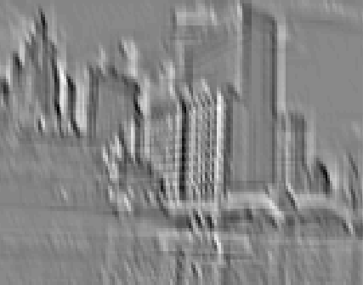


1. Convolution
Dependencies are local
Translation invariance
Few parameters (filter weights)
Stride can be greater than 1 (faster, less memory)
.
.
.
Input
Feature Map
Notes:
hi

Slide 23
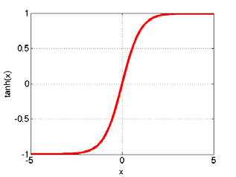
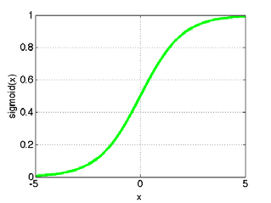
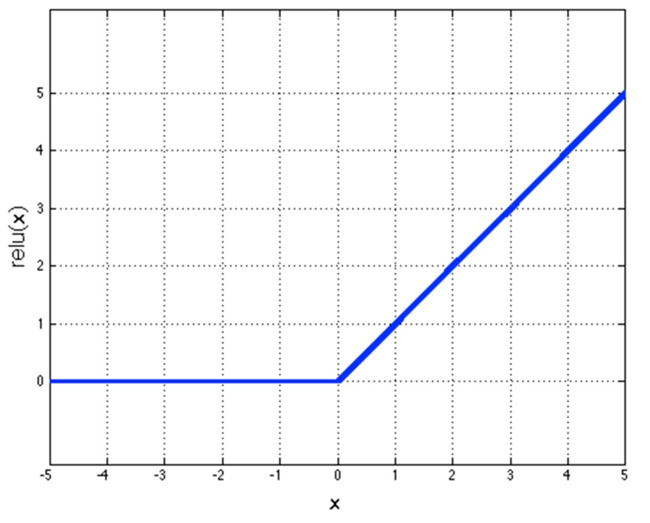
2. Non-Linearity
Per-element (independent)
Options:
Tanh
Sigmoid: 1/(1+exp(-x))
Rectified linear unit (ReLU)
Simplifies backpropagation
Makes learning faster
Avoids saturation issues
→ Preferred option

Slide 24
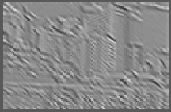
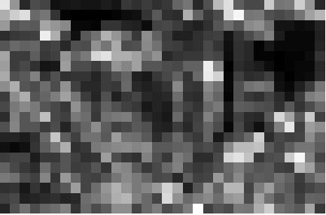
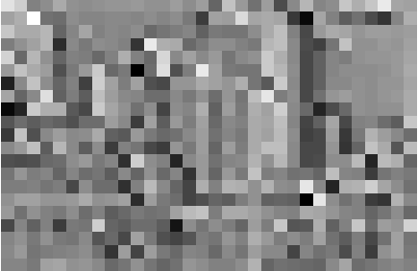
3. Spatial Pooling
Sum or max
Non-overlapping / overlapping regions
Role of pooling:
Invariance to small transformations
Larger receptive fields (see more of input)
Max
Sum

Slide 25
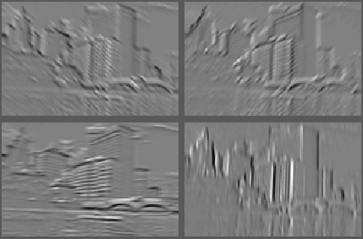
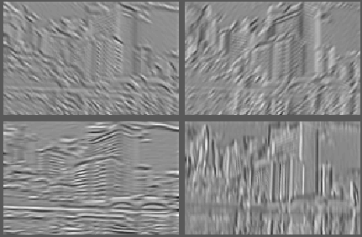
4. Normalization
Within or across feature maps
Before or after spatial pooling
Feature Maps
After Contrast Normalization
Feature Maps

Slide 26
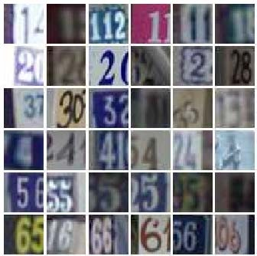
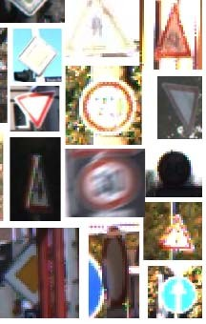
Convnet Successes
Handwritten text/digits
MNIST (0.17% error [Ciresan et al. 2011])
Arabic & Chinese [Ciresan et al. 2012]
Simpler recognition benchmarks
CIFAR-10 (9.3% error [Wan et al. 2013])
Traffic sign recognition
– 0.56% error vs 1.16% for humans [Ciresan et al. 2011]
But until recently, less good at more complex datasets
Caltech-101/256 (few training examples)

Slide 27

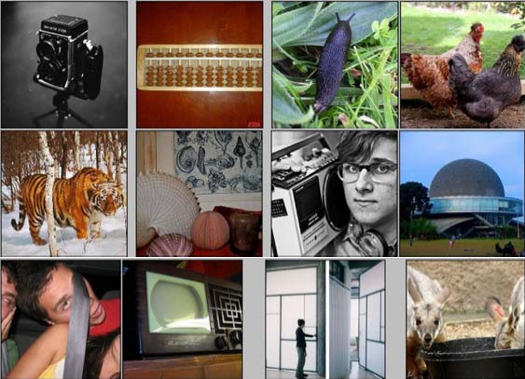
ImageNet Challenge 2012
~14 million labeled images, 20k classes
Images gathered from Internet
Human labels via Amazon Turk
Challenge: 1.2 million training images, 1000 classes
[Deng et al. CVPR 2009]
A. Krizhevsky, I. Sutskever, and G. Hinton, ImageNet Classification with Deep
Convolutional Neural Networks, NIPS 2012

Slide 28
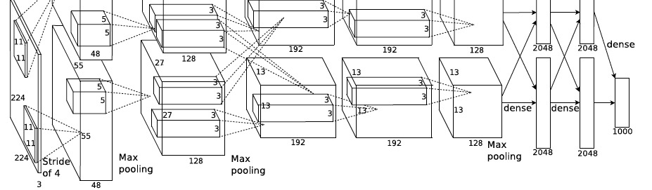
ImageNet Challenge 2012
Similar framework to LeCun’98 but:
Bigger model (7 hidden layers, 650,000 units, 60,000,000 params)
More data (10⁶ vs. 10³ images)
GPU implementation (50x speedup over CPU)
Trained on two GPUs for a week
Better regularization for training (DropOut)
A. Krizhevsky, I. Sutskever, and G. Hinton, ImageNet Classification with Deep
Convolutional Neural Networks, NIPS 2012

Slide 29





ImageNet Challenge 2012
Krizhevsky et al. -- 16.4% error (top-5) Next best (non-convnet) – 26.2% error
35
30
25
20
15
10
5
0
Top-5 error rate %
SuperVision
ISI
Oxford
INRIA
Amsterdam

Slide 30
Overview
Shallow vs. deep architectures
Background
Traditional neural networks
Inspiration from neuroscience
CNN - Basics
Stages of CNN architecture
Visualizing CNNs
State-of-the-art results
Packages
Applying to detect bumps

Slide 31
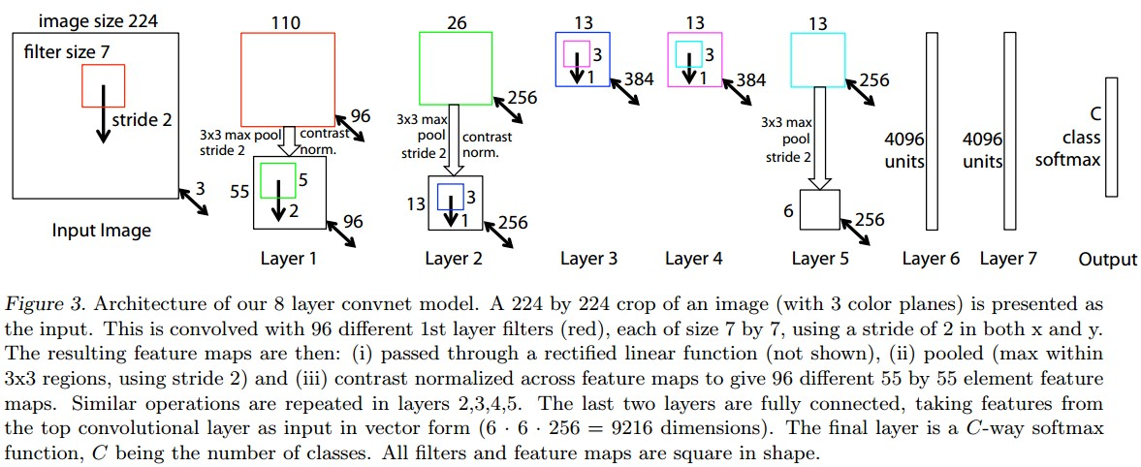
Visualizing Convnets
M. Zeiler and R. Fergus, Visualizing and Understanding Convolutional Networks, arXiv preprint, 2013

Slide 32
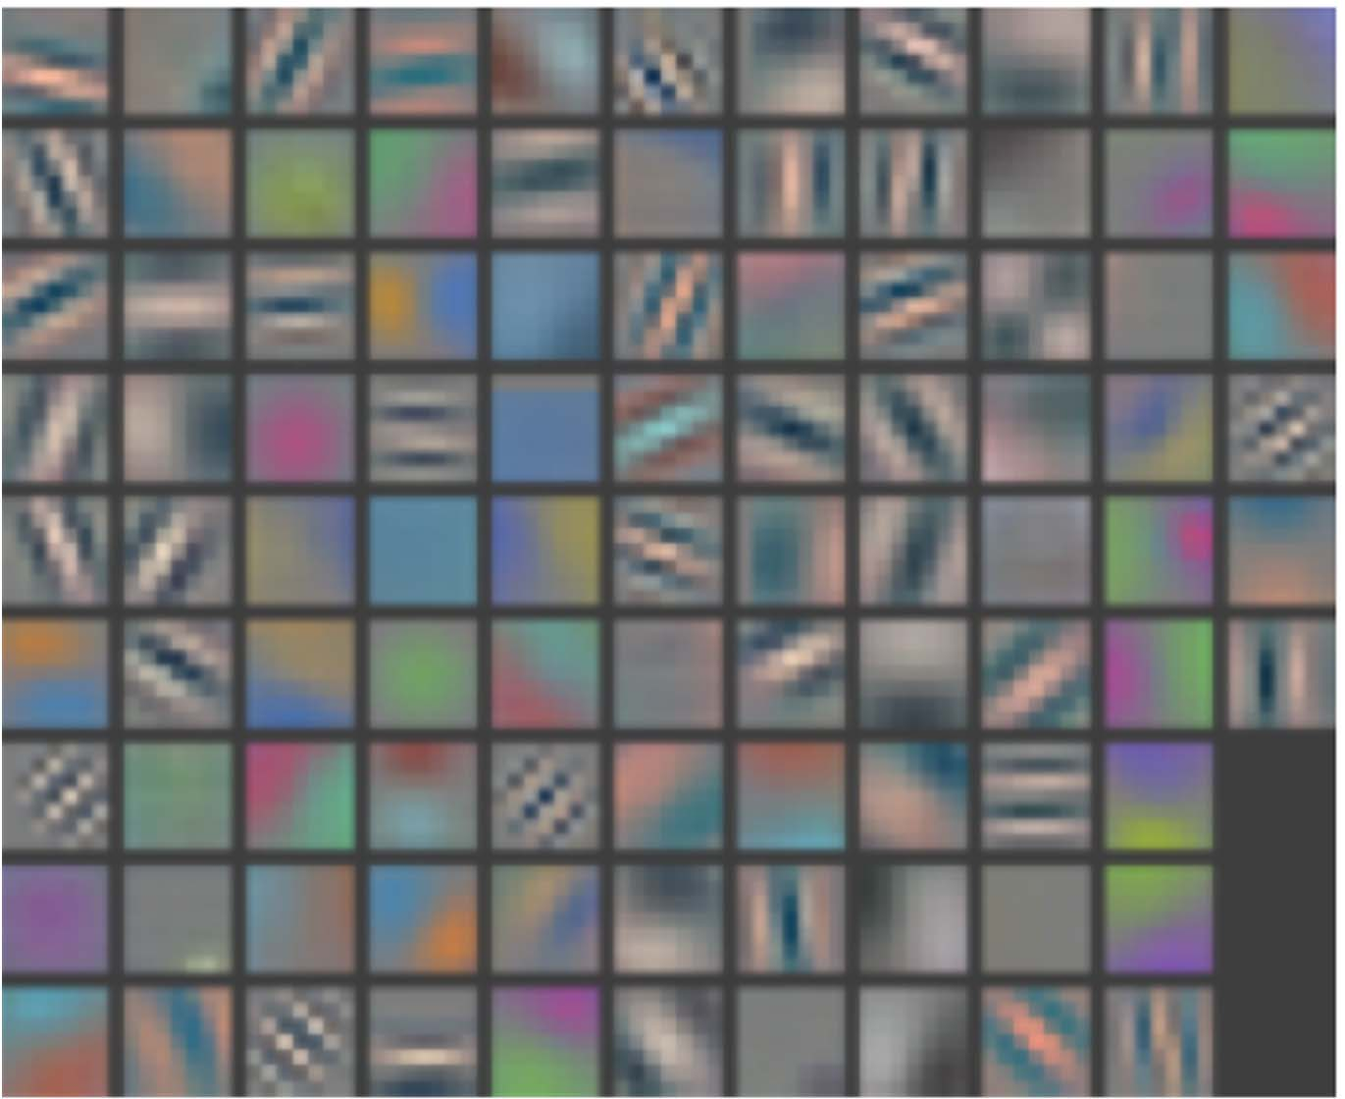
Layer 1 Filters

Slide 33
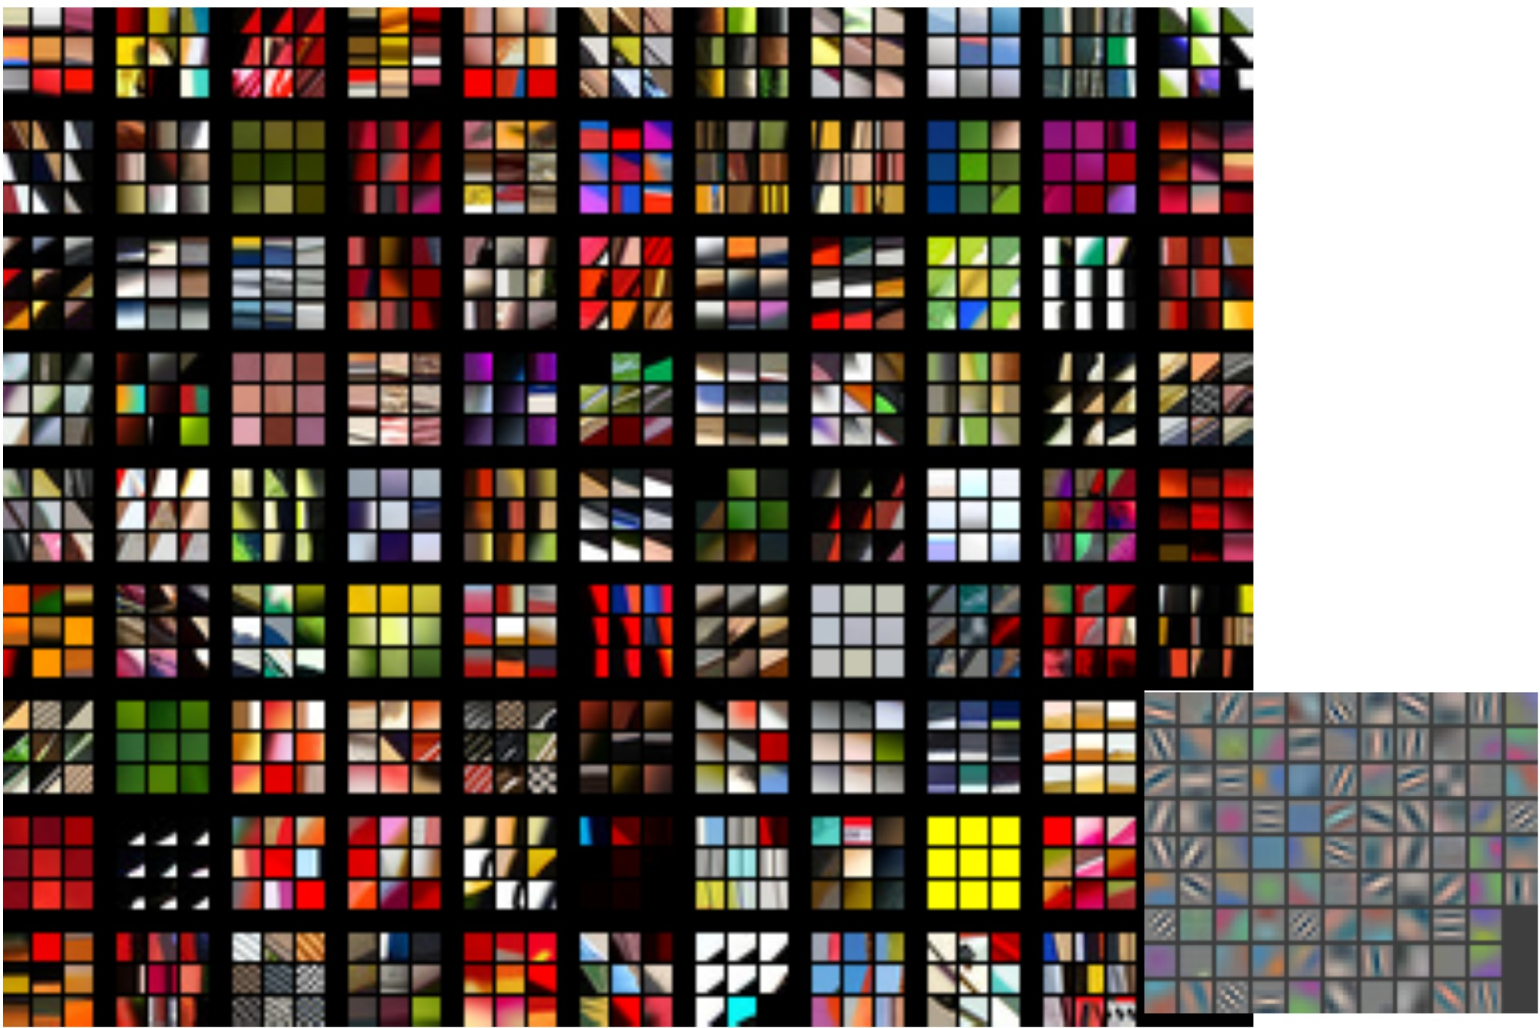
Layer 1: Top-9 Patches

Slide 34
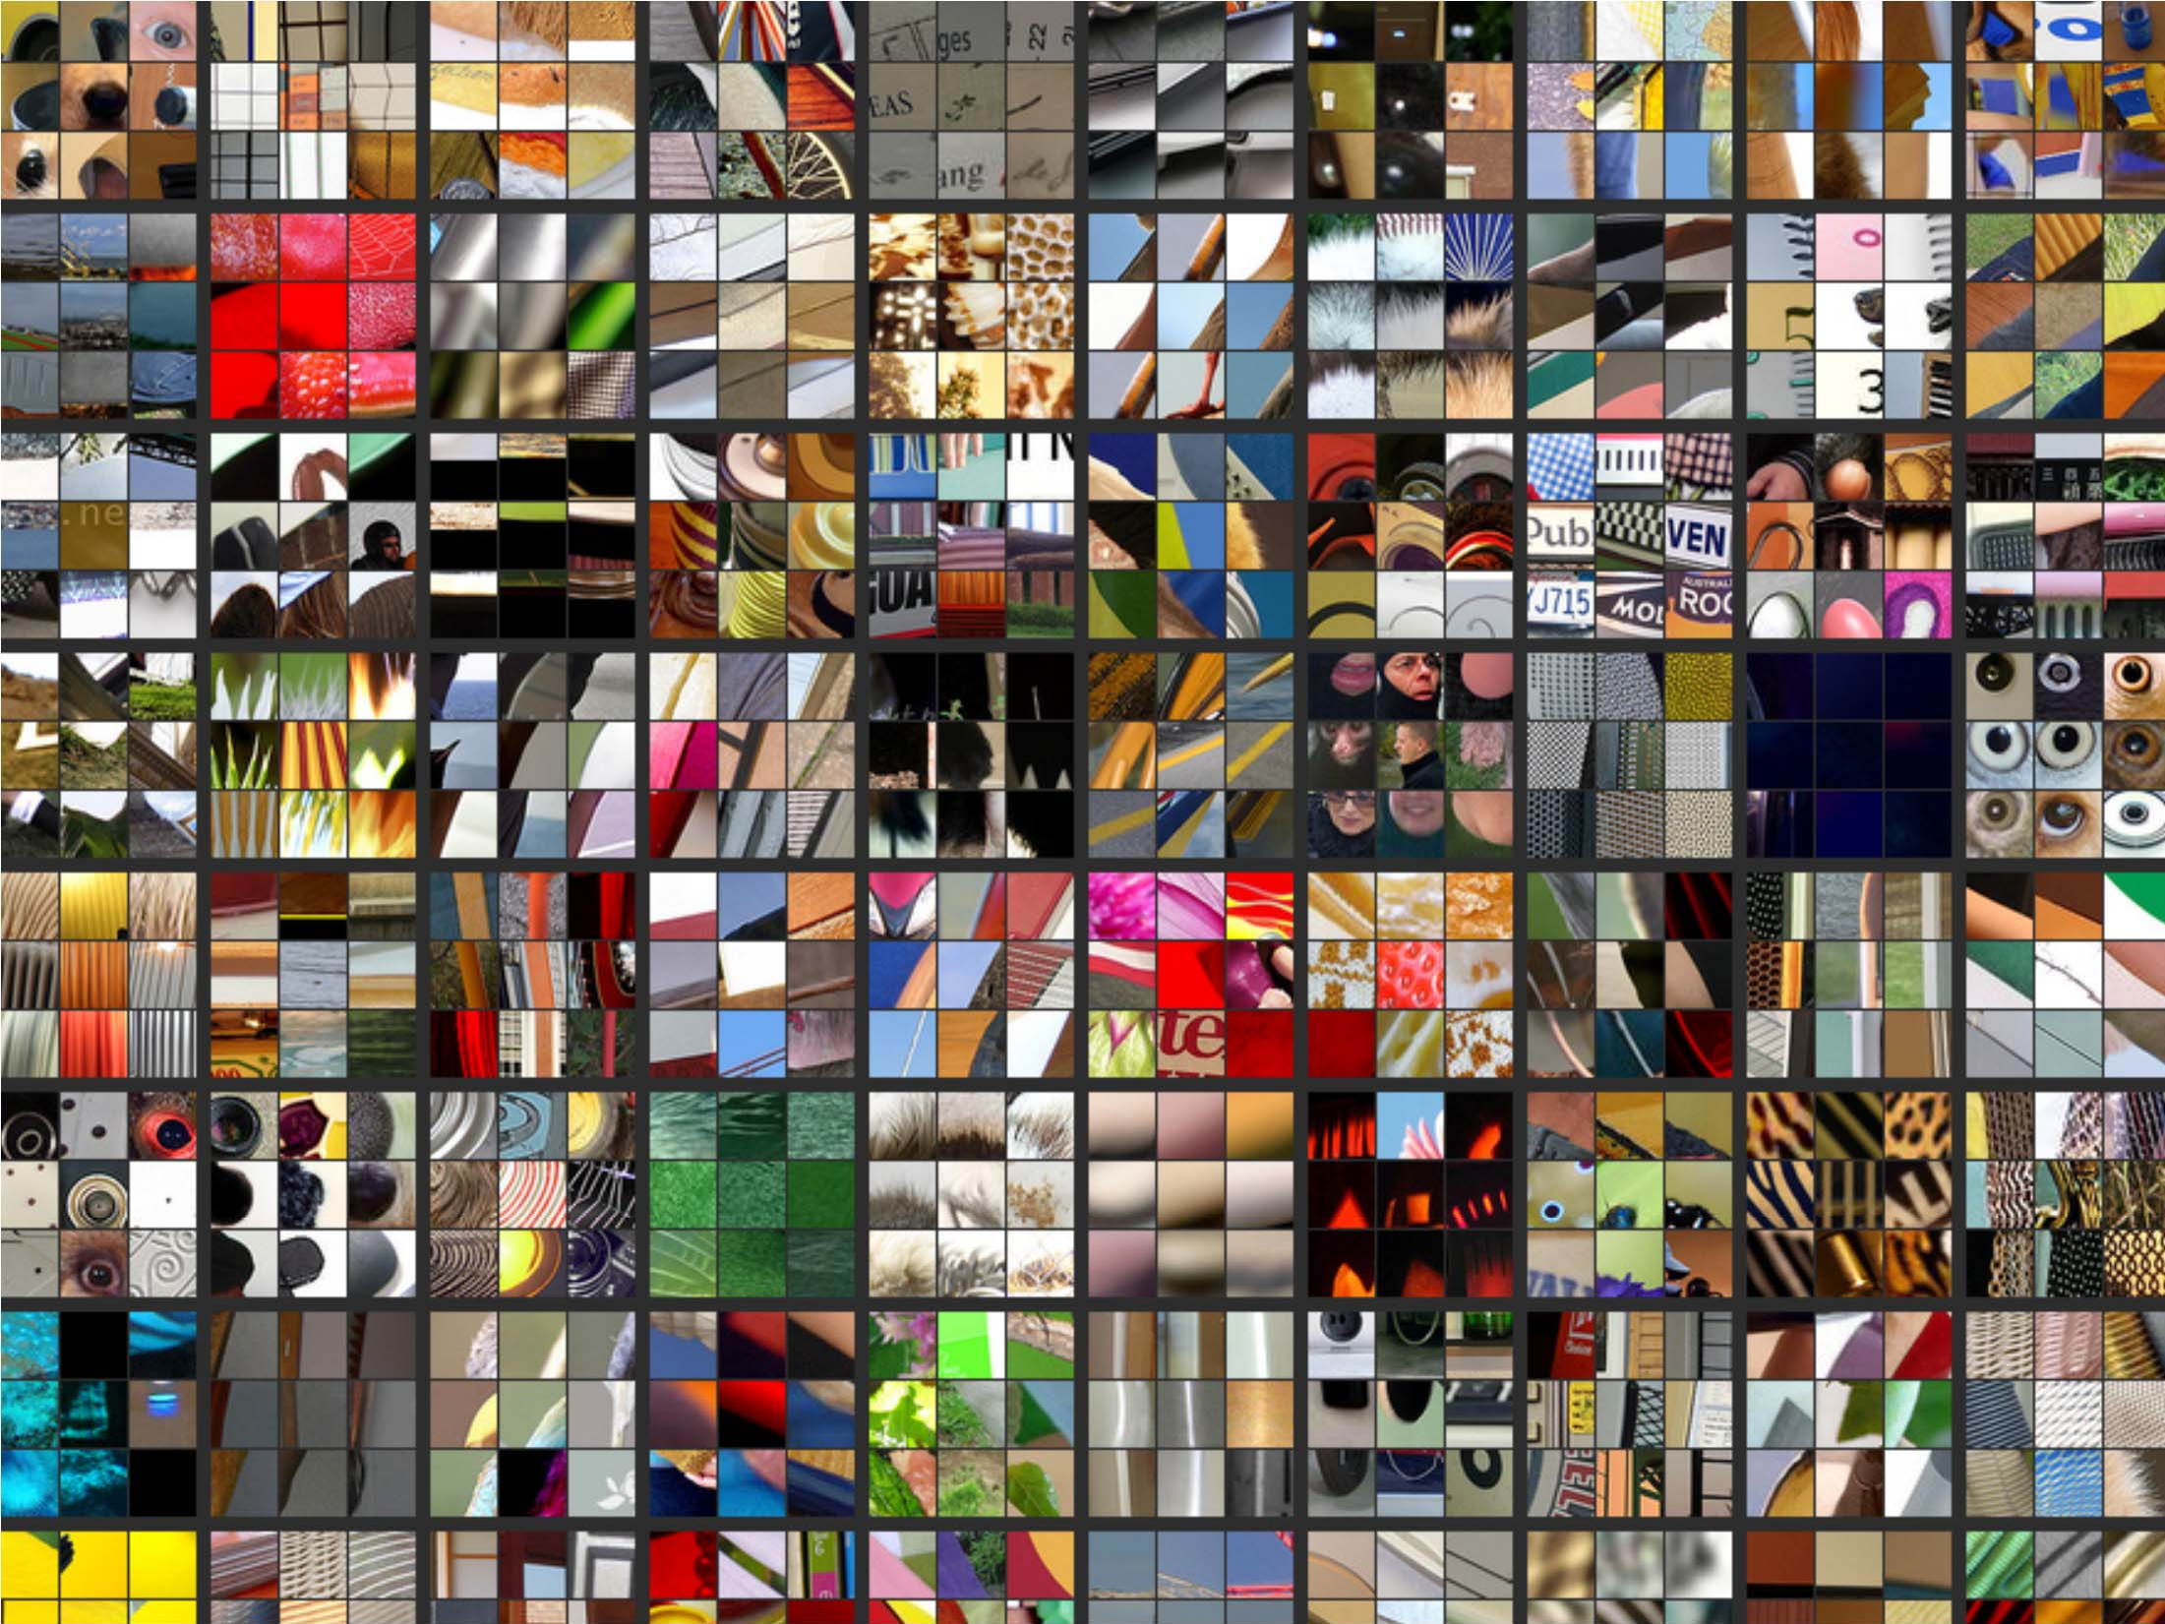
Layer 2: Top-9 Patches
Patches from validation images that give maximal activation of a given feature map

Slide 35
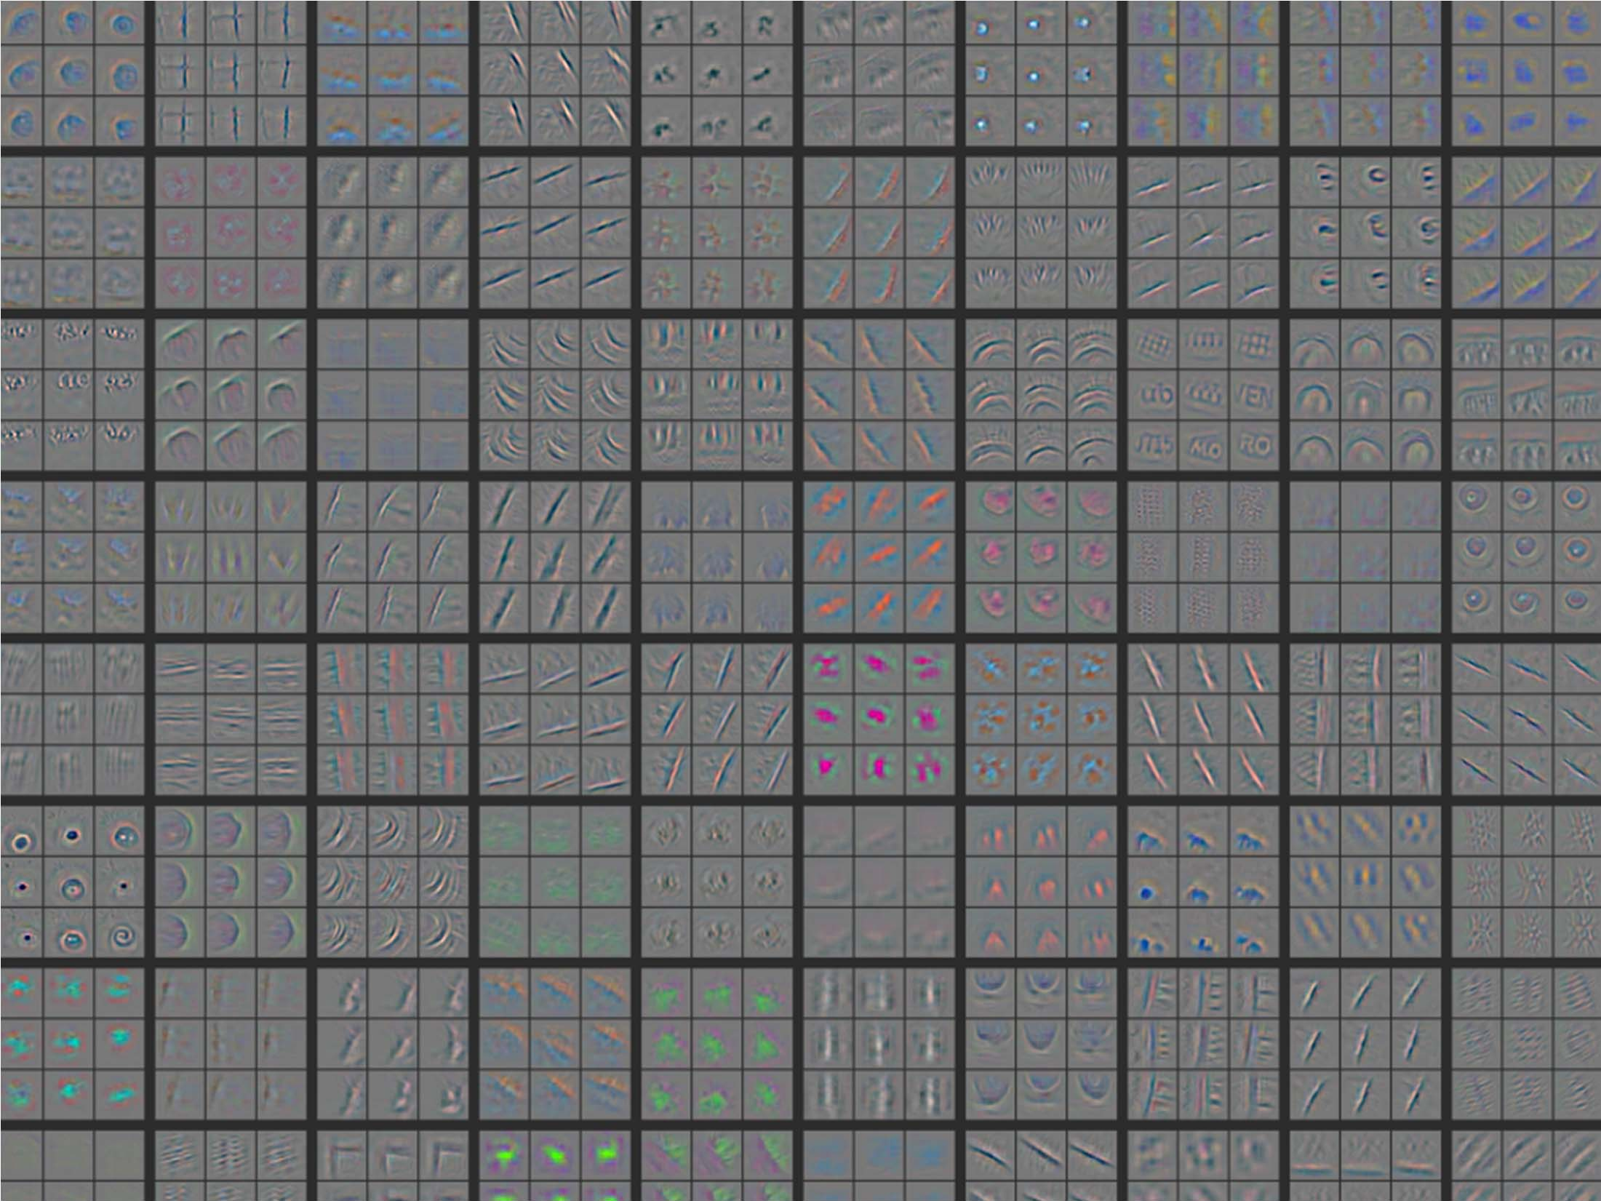
Layer 2: Top-9 Patches

Slide 36
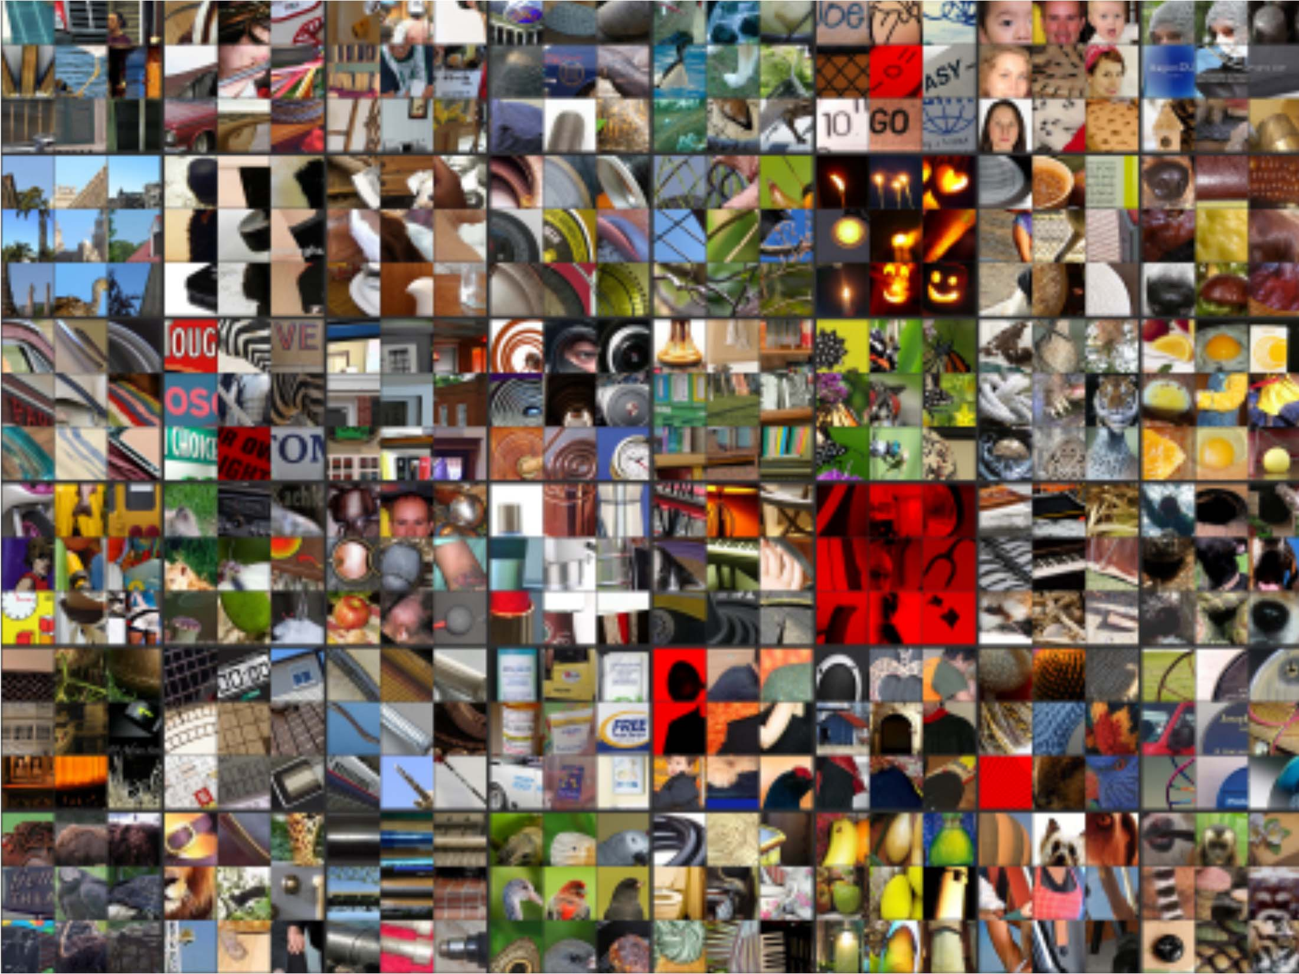
Layer 3: Top-9 Patches

Slide 37
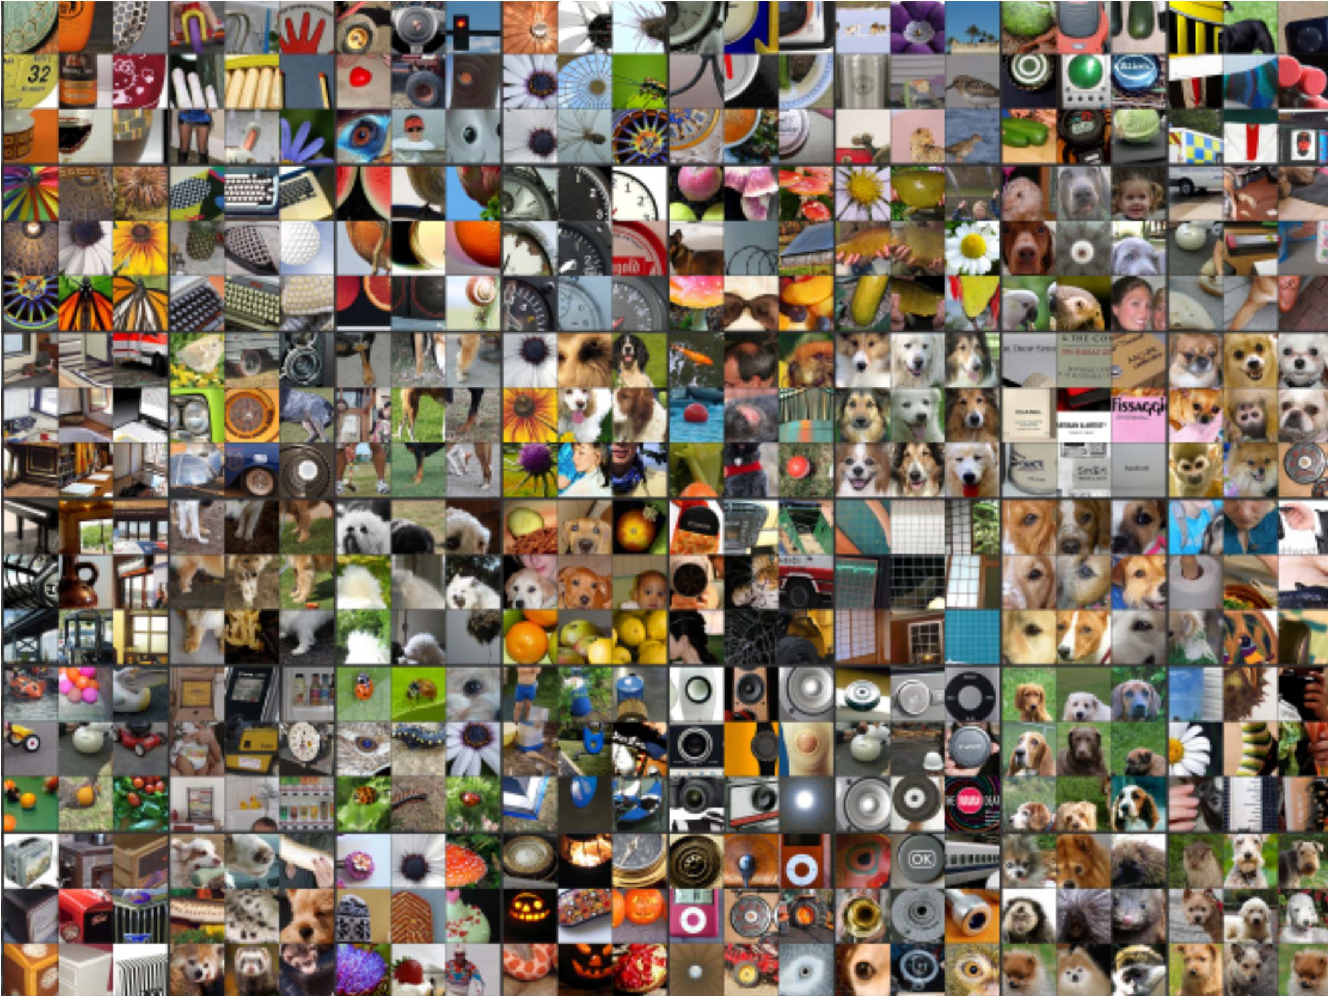
Layer 4: Top-9 Patches

Slide 38
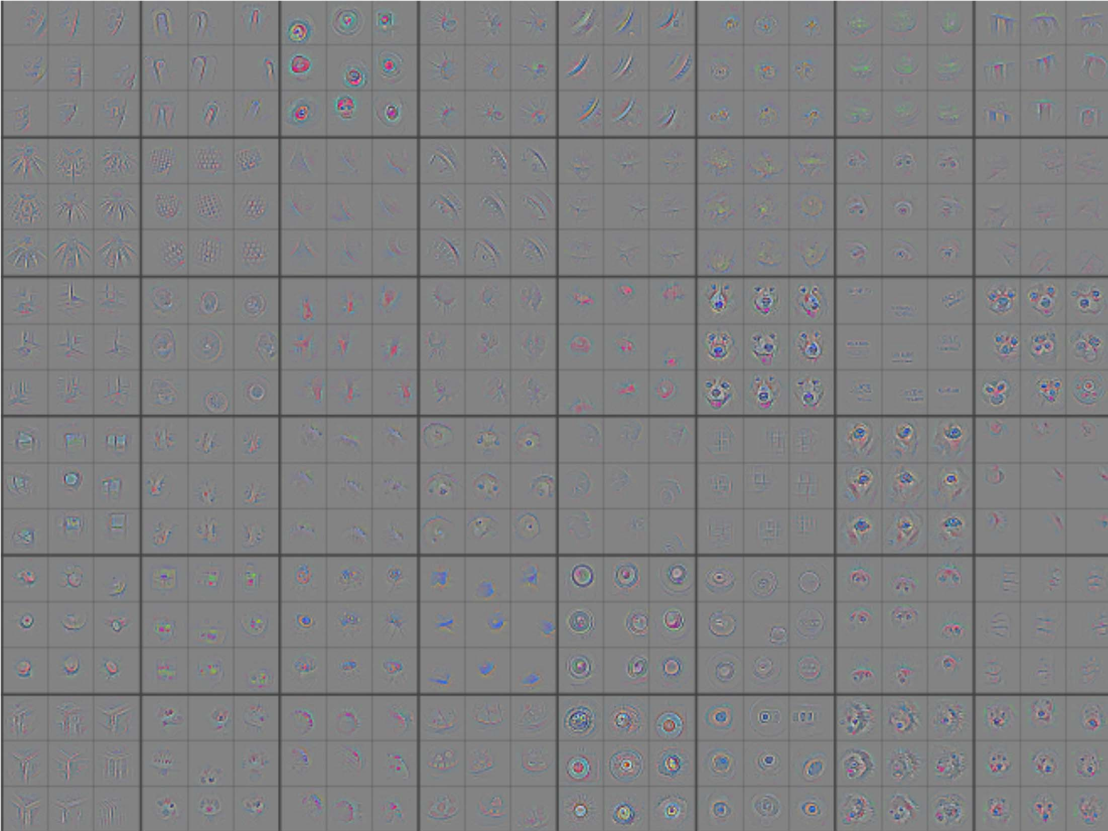
Layer 4: Top-9 Patches

Slide 39
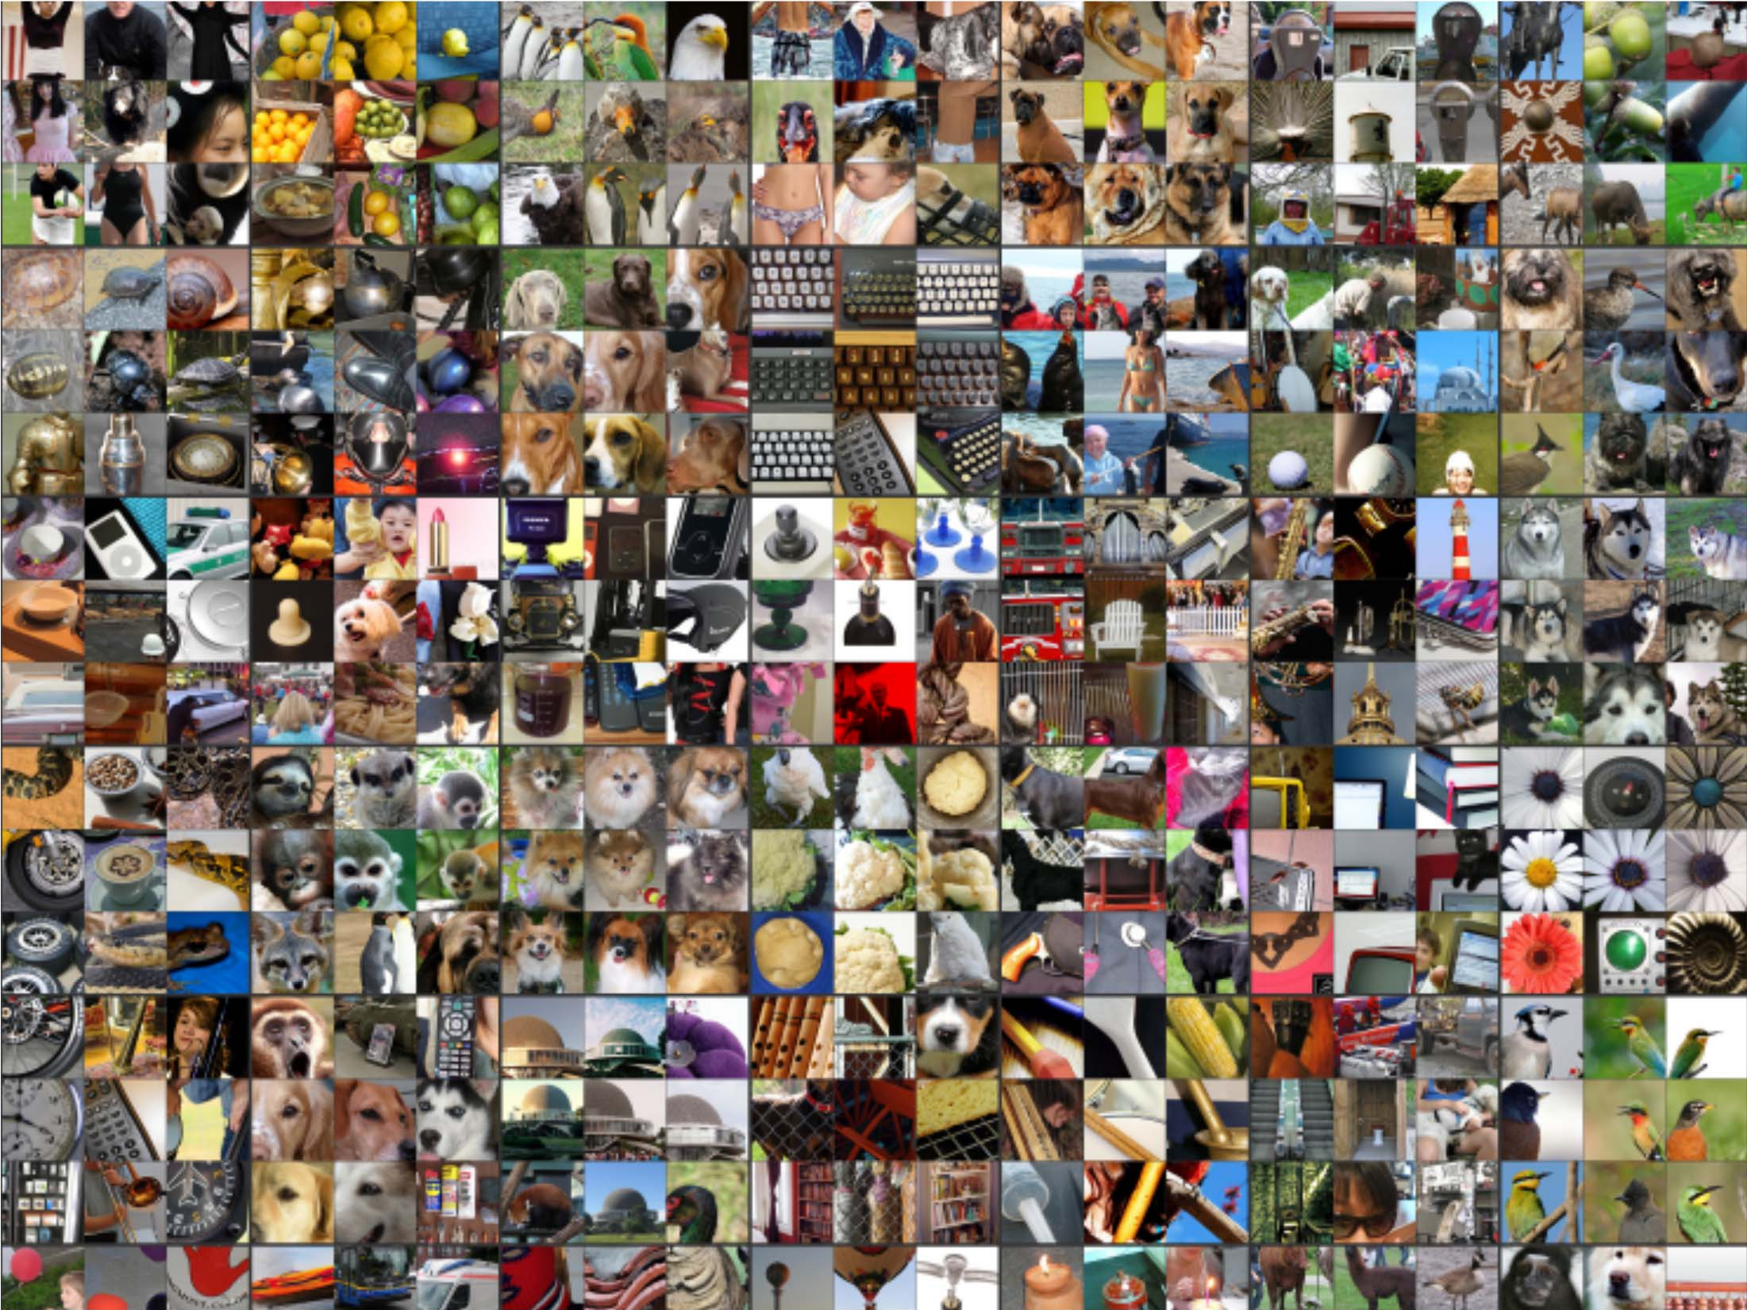
Layer 5: Top-9 Patches

Slide 40
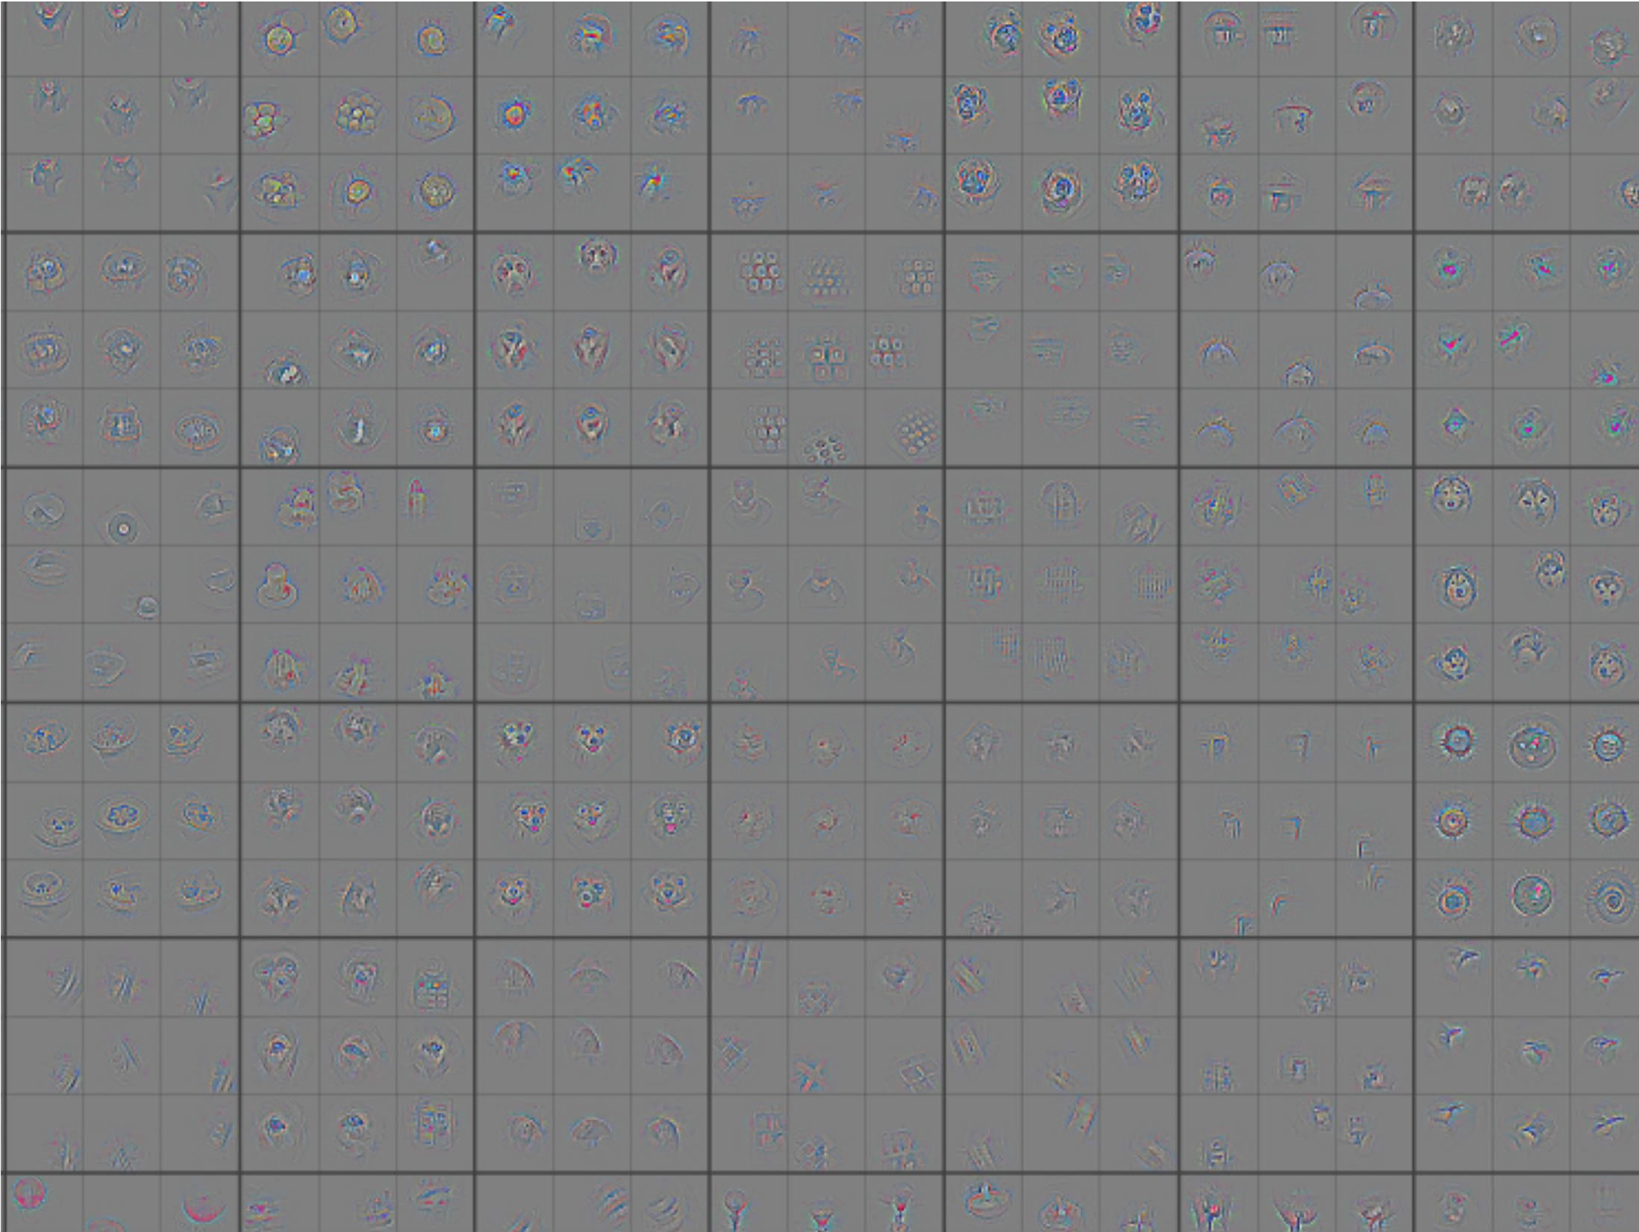
Layer 5: Top-9 Patches

Slide 41
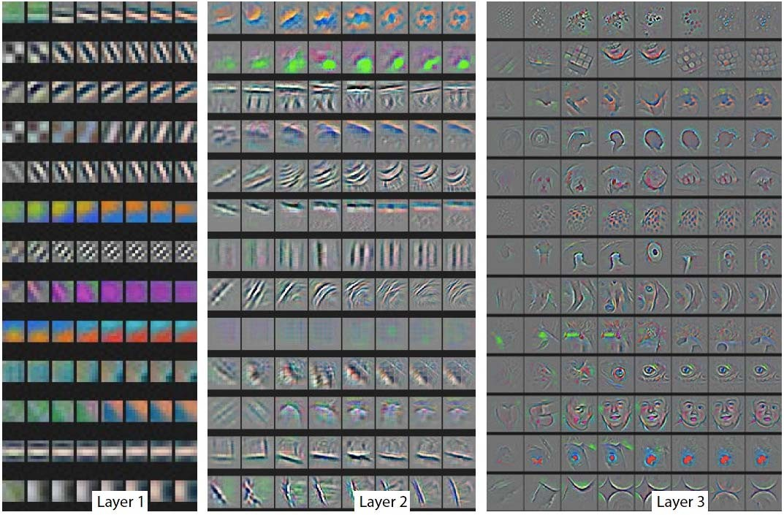
Evolution of Features During Training

Slide 42
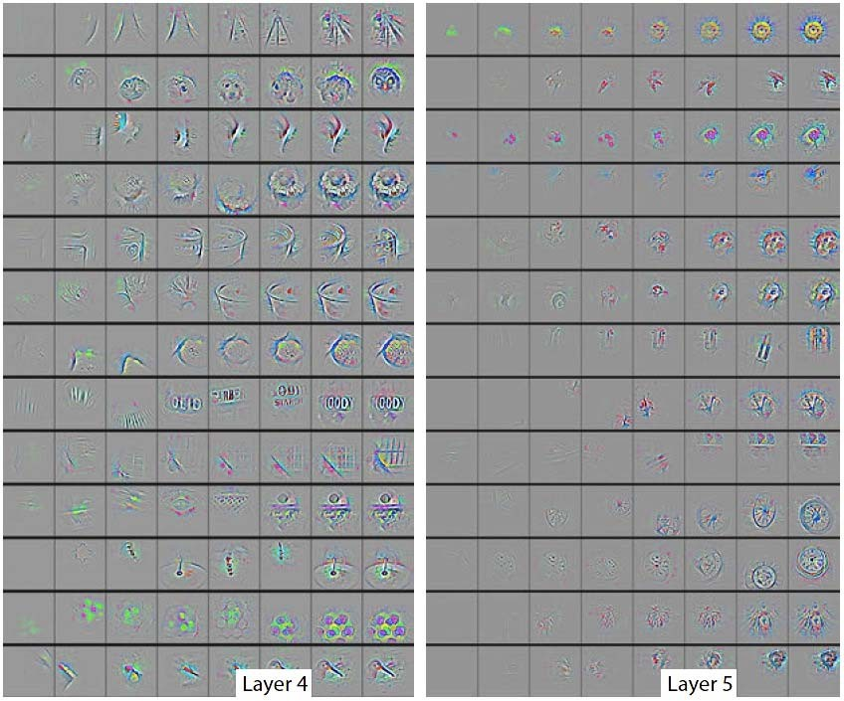
Evolution of Features During Training

Slide 43
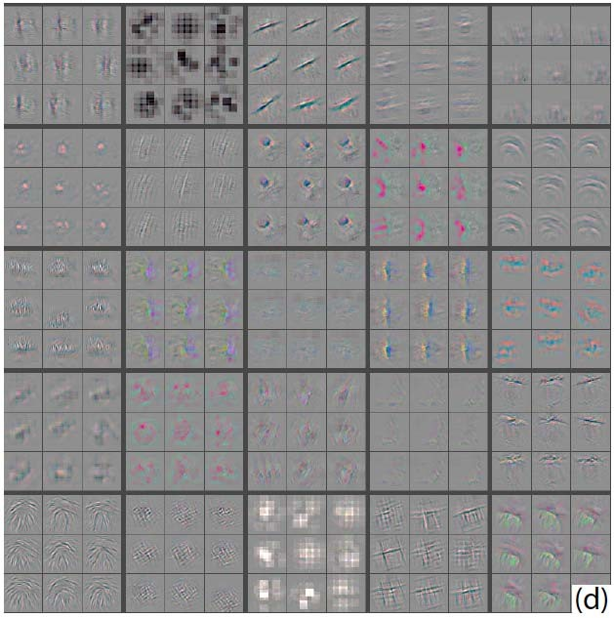
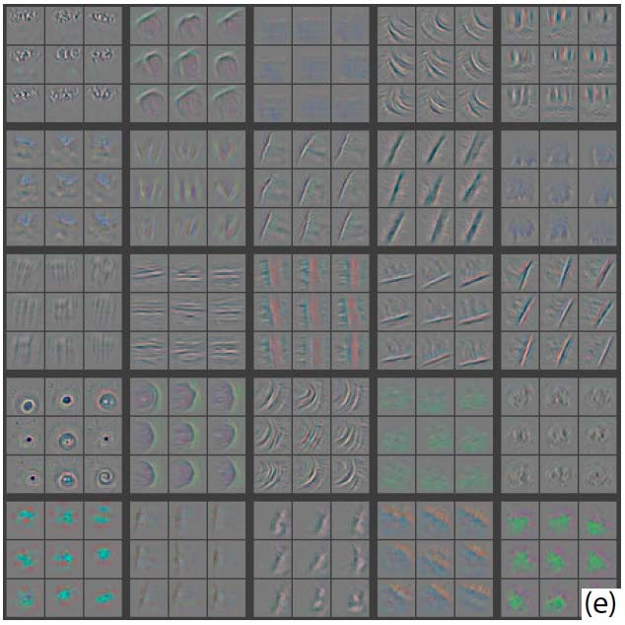
Diagnosing Problems
Visualization of Krizhevsky et al.’s architecture showed some problems with layers 1 and 2
Large stride of 4 used
Alter architecture: smaller stride & filter size
Visualizations look better
Performance improves
Krizhevsky et al.
Zeiler and Fergus

Slide 44
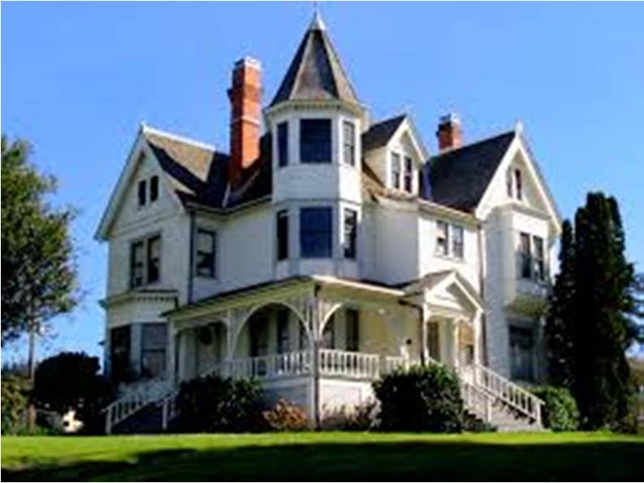
Occlusion Experiment
Mask parts of input with occluding square
Monitor output

Slide 45
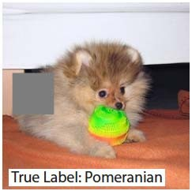
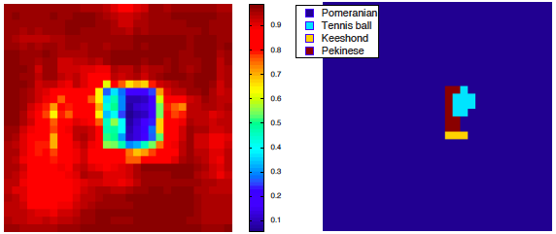
Input image
p(True class)
Most probable class

Slide 46
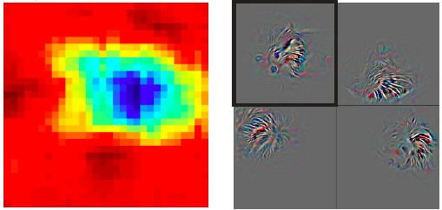
Input image
Total activation in most active 5th layer feature map
Other activations from same feature map

Slide 47
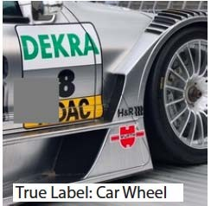
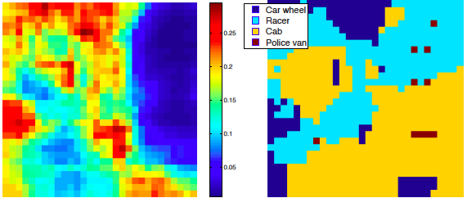
Input image
p(True class)
Most probable class

Slide 48

Input image
Total activation in most active 5th layer feature map
Other activations from same feature map

Slide 49


Input image
p(True class)
Most probable class

Slide 50

Input image
Total activation in most active 5th layer feature map
Other activations from same feature map

Slide 51















ImageNet Classification 2013 Results
http://www.image-net.org/challenges/LSVRC/2013/results.php Demo: http://www.clarifai.com/
0.17
0.16
0.15
0.14
0.13
0.12
0.11
0.1
Test error (top-5)

Slide 52

How important is depth?
Softmax Output
Architecture of Krizhevsky et al.
8 layers total
Trained on ImageNet 18.1% top-5 error
Layer 7: Full
Layer 6: Full
Layer 5: Conv + Pool
Layer 4: Conv
Layer 3: Conv
Layer 2: Conv + Pool Layer 1: Conv + Pool
Input Image

Slide 53

How important is depth?
Softmax Output
Remove top fully connected layer
Layer 7
Drop 16 million parameters
Only 1.1% drop in performance!
Layer 6: Full
Layer 5: Conv + Pool
Layer 4: Conv
Layer 3: Conv
Layer 2: Conv + Pool Layer 1: Conv + Pool
Input Image

Slide 54

How important is depth?
Softmax Output
Remove both fully connected layers
Layer 6 & 7
Drop ~50 million parameters 5.7% drop in performance
Layer 5: Conv + Pool
Layer 4: Conv
Layer 3: Conv
Layer 2: Conv + Pool Layer 1: Conv + Pool
Input Image

Slide 55

How important is depth?
Softmax Output
Now try removing upper feature extractor layers:
Layers 3 & 4
Layer 7: Full
Layer 6: Full
Layer 5: Conv + Pool
Drop ~1 million parameters
3.0% drop in performance
Layer 2: Conv + Pool
Layer 1: Conv + Pool
Input Image

Slide 56
How important is depth?
Softmax Output
Now try removing upper feature extractor layers & fully connected:
• Layers 3, 4, 6 ,7
Layer 5: Conv + Pool
Now only 4 layers
33.5% drop in performance
Layer 2: Conv + Pool
→Depth of network is key
Layer 1: Conv + Pool
Input Image

Slide 57

Tapping off Features at each Layer
Plug features from each layer into linear SVM or soft-max

Slide 58
Overview
Shallow vs. deep architectures
Background
Traditional neural networks
Inspiration from neuroscience
CNN - Basics
Stages of CNN architecture
Visualizing CNNs
State-of-the-art results
Packages
Applying to detect bumps

Slide 59
CNN packages
Cuda-convnet (Alex Krizhevsky, Google)
Theano (Python libraries)
Torch (Lua)
Caffe (Y. Jia, Berkeley)
NVIDIA DIGITS (Web UI)

Slide 60
Caffe - Overview
Solver prototxt
Train prototxt
*.caffemodel files
Data formats – LevelDB, LMDB, HDF5
Snapshot the model after some iterations.

Slide 61
Solver prototxt (Sample)
test_iter: 100 test_interval: 155 base_lr: 0.01 display: 19 max_iter: 4650 lr_policy: "step" gamma: 0.1 momentum: 0.9 weight_decay: 0.0005 stepsize: 1535 snapshot: 155 snapshot_prefix: "snapshot" solver_mode: GPU net: "train_val.prototxt" solver_type: SGD

Slide 62
Train_val prototxt
layer { name: "conv1"
type: "Convolution“
param { lr_mult: 1 }
param { lr_mult: 2 }
convolution_param {
num_output: 20
kernel_size: 5
stride: 1
weight_filler { type: "xavier" }
bias_filler { type: "constant" } }
bottom: "data" top: "conv1" }
layer {
name: "pool1“
type: "Pooling“
pooling_param { kernel_size: 2
stride: 2
pool: MAX }
bottom: "conv1" top: "pool1" }

Slide 63
More about Caffe
http://vision.stanford.edu/teaching/cs231n/slides/caffe_tutorial.pdf

Slide 64
Overview
Shallow vs. deep architectures
Background
Traditional neural networks
Inspiration from neuroscience
CNN - Basics
Stages of CNN architecture
Visualizing CNNs
State-of-the-art results
Packages
Applying to detect bumps

Slide 65



Quasar 2175 Å Dust Absorber
Interstellar dust grains play an important role in the evolution of galaxies, star formation, and planet formation. The size distribution and composition of dust grains are mainly inferred from the observed extinction curve and the re-radiated infrared emission.
The high-z quasar 2175Å absorbers are a new, extremely rare population of quasar absorption line systems, distinguished by broad dust absorption bumps at 2175Å of the absorber’s rest frame in the extinction curves derived from the quasar spectra.

Slide 66







Classic Approach to probe Quasar 2175 Å Dust Absorber

Slide 67




How do we find them in the SDSS Database?
The identification technique is called the “quasar spectra pair method”. The reddened spectrum is a observed quasar spectrum, and the unreddened is replaced by the SDSS quasar composite spectrum.
Then the extinction curve can be obtained by:

Slide 68



Limitation of the identification technique:
The identification of 2175 bump is based on Mgii absorber catalog:
We can only identify the 2175 bump in the redshift range from 0.7 to 2.5.
The method is based on Mg II absorber catalog. If the Mg ii absorber catalog is not complete, the 2175 bump sample may not be complete.

Slide 69




With Bumps

Slide 70




Without Bumps

Slide 71
Data Transformation
Input:4,600-4,700 values of Flux and wavelength for each instance
Normalise the Flux values to 0-255 and represent it as pixel intensity in Greyscale image.
Input image dimension:69x69x1
Two approaches followed in reshaping vector to image:
Zig-Zag approach
Normal approach

Slide 72
Training and Validation
We have used convolution neural network for training.
Two stacks of convolution-pooling layers followed by two fully connected layers.
We have used 10k instances of synthesized data for training and 10k instances of real data for validation.

Slide 73


Slide 74
Layer dimensions and parameters
Layer | Neurons | Weights
Input | 69x69x1
Conv1 | 65x65x20 | 5x5x1x20
Pool1 | 33x33x20
Conv2 | 29x29x50 | 5x5x1x50
Pool2 | 15x15x50
FC1 | 1000 | 11.2M
FC2 | 2 | 2k

Slide 75


Results – Train and val on simulated data
97.2% Accuracy on validaton set.

Slide 76

Results – Normal reshaping
88% Accuracy | False Negatives: 4.15% | False Positives: 7.84%

Slide 77

Zig-zag reshaping
87% Accuracy (1% lesser)

Slide 78
Observations
Seen that by training with 2k less instances, accuracy has dropped by ~2-2.5%
So, Clearly, More data -> Better results.
Adding more layers with same amount of data reduces accuracy due to overfitting.

Slide 79
Using CNN Features on Other Datasets
Take model trained on, e.g., ImageNet 2012 training set
Take outputs of 6th or 7th layer before or after nonlinearity
Classify test set of new dataset
Optional: fine-tune features and/or classifier on new dataset

Slide 80




Results on misc. benchmarks
[1] Caltech-101 (30 samples per class)
[1] SUN 397 dataset (DeCAF)
[2] MIT-67 Indoor Scenes dataset (OverFeat)
[1] Caltech-UCSD Birds (DeCAF)
[1] J. Donahue, Y. Jia, O. Vinyals, J. Hoffman, N. Zhang, E. Tzeng, and T. Darrell, DeCAF: A Deep Convolutional Activation Feature for Generic Visual Recognition, arXiv preprint, 2014
[2] A. Razavian, H. Azizpour, J. Sullivan, and S. Carlsson, CNN Features off-the-shelf: an Astounding Baseline for Recognition, arXiv preprint, 2014

Slide 81

CNN features for detection
Object detection system overview. Our system (1) takes an input image, (2) extracts around 2000 bottom-up region proposals, (3) computes features for each proposal using a large convolutional neural network (CNN), and then (4) classifies each region using class-specific linear SVMs. R-CNN achieves a mean average precision (mAP) of 53.7% on PASCAL VOC 2010. For comparison, Uijlings et al. (2013) report 35.1% mAP using the same region proposals, but with a spatial pyramid and bag-of-visual- words approach. The popular deformable part models perform at 33.4%.
R. Girshick, J. Donahue, T. Darrell, and J. Malik, Rich Feature Hierarchies for Accurate Object Detection and Semantic Segmentation, CVPR 2014, to appear.

Slide 82


CNN features for face verification
Y. Taigman, M. Yang, M. Ranzato, L. Wolf, DeepFace: Closing the Gap to Human-Level Performance in Face Verification, CVPR 2014, to appear.

Slide 83
References
http://www.slideshare.net/kuwajima/cnnbp
http://ufldl.stanford.edu/tutorial/supervised/ConvolutionalNeuralNetwork/

